Slide 1
Preemptive Examples for Lab

Slide 2
Example for Preemptive SJF (SRTF)
Process Arrival Time Burst Time
P₁ 0.0 7
P₂ 2.0 4
P₃ 4.0 1
P₄ 5.0 4
Time 0 – P₁ gets the CPU Ready = [(P₁,7)]
Time 2 – P₂ arrives – CPU has P₁ with rem. time=5, Ready = [(P₂,4)] – P₂ gets the CPU
Time 4 – P₃ arrives – CPU has P₂ with rem. time = 2, Ready = [(P₁,5),(P₃,1)] – P₃ gets the CPU
P₁
P₂
P₃
2
4
5

Slide 3
Example for Preemptive SJF (SRTF)
Process Arrival Time Burst Time
P₁ 0.0 7
P₂ 2.0 4
P₃ 4.0 1
P₄ 5.0 4
Time 5 – P₃ completes and P₄ arrives - Ready = [(P₁,5),(P₂,2),(P₄,4)] – P₂ gets the CPU
Time 7 – P₂ completes – Ready = [(P₁,5),(P₄,4)] – P₄ gets the CPU
Time 11 – P₄ completes, P₁ gets the CPU
P₁
P₂
P₃
P₂
P₄
P₁
5
7
11
16

Slide 4
Example for Preemptive SJF (SRTF)
Process Arrival Time Burst Time
P₁ 0.0 7
P₂ 2.0 4
P₃ 4.0 1
P₄ 5.0 4
SJF (preemptive)
Waiting Time for Processes:
P1=(0+(11-2))=9, P2=((2-2)+(5-4))=1, P3=(4-4)=0, P4=(7-5)=2
Average waiting time = (9 + 1 + 0 +2)/4 = 3
P₁
P₂
P₃
P₂
P₄
P₁
2
4
5
7
11
16

Slide 5
Example of Shortest-remaining-time-first
Now we add the concepts of varying arrival times and preemption to the analysis
ProcessA arri Arrival TimeT Burst Time
P₁ 0 8
P₂ 1 4
P₃ 2 9
P₄ 3 5
????
Try solving this…………

Slide 6
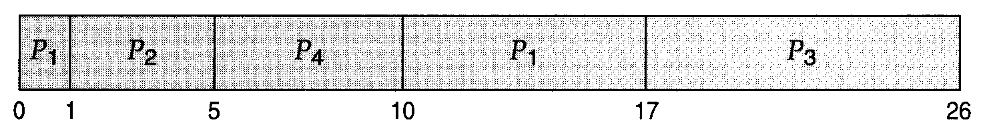
Example of Shortest-remaining-time-first
ProcessA arri Arrival TimeT Burst Time
P₁ 0 8
P₂ 1 4
P₃ 2 9
P₄ 3 5
Time 0 – P₁ gets the CPU Ready = [(P₁,8)]
Time 1 – P₂ arrives – CPU has P₁ with rem. time=7, Ready = [(P₂,4)] – P₂ gets the CPU
Time 2 – P₃ arrives – CPU has P₂ with rem. time = 3, Ready = [(P₁,7)(P₃,9)] – P2 continues with the CPU
Time 3- P4 arrives- CPU has P2 with rem. time=2, Ready =[(P₁,7)(P₃,9)(P4,5)] – P2 continues with the CPU
After P2 finishes, then P4 executes , then P1 , finally P3
Preemptive SJF Gantt Chart
Average waiting time = [(10-1)+(1-1)+(17-2)+(5-3)]/4 = 26/4 = 6.5 msec

Slide 7

Example of RR with Time Quantum = 4
Process Burst Time
P₁ 24
P₂ 3
P₃ 3
The Gantt chart is:
Typically, higher average turnaround than SJF, but better response

Slide 8
Preemptive Priority Scheduling
Process Id | Priority | Arrival Time | Burst Time
1 | 2 | 0 | 1
2 | 6 | 1 | 7
3 | 3 | 2 | 3
4 | 5 | 3 | 6
5 | 4 | 4 | 5
6 | 10 | 5 | 15
7 | 9 | 15 | 8

Slide 9


Preemptive Priority Scheduling
Process Id | Priority | Arrival Time | Burst Time
1 | 2 | 0 | 1
2 | 6 | 1 | 7
3 | 3 | 2 | 3
4 | 5 | 3 | 6
5 | 4 | 4 | 5
6 | 10 | 5 | 15
7 | 9 | 15 | 8
At time=0, P1 arrives with the burst time of 1 units and priority 2.
Since no other process is available hence this will be scheduled till next job arrives or its completion (whichever is lesser).
Ready Queue={(P1,BT=1,PR=2)}
√
At time=1, P2 arrives.
P1 terminates
No other process is available at this time hence the Operating system has to schedule P2 regardless of the priority assigned to it.
Ready Queue={(P2,BT=7,PR=6)}

Slide 10

Preemptive Priority Scheduling
Process Id | Priority | Arrival Time | Burst Time
1 | 2 | 0 | 1
2 | 6 | 1 | 7
3 | 3 | 2 | 3
4 | 5 | 3 | 6
5 | 4 | 4 | 5
6 | 10 | 5 | 15
7 | 9 | 15 | 8
At Time=2
P3 arrives , the priority of P3 is higher to P2.
Ready Queue={(P3,BT=3,PR=3)}
P2 with Remaining Time=6,PR=6
P2 is Pre-empted
P3 is selected
√

Slide 11

Preemptive Priority Scheduling
Process Id | Priority | Arrival Time | Burst Time
1 | 2 | 0 | 1
2 | 6 | 1 | 7
3 | 3 | 2 | 3
4 | 5 | 3 | 6
5 | 4 | 4 | 5
6 | 10 | 5 | 15
7 | 9 | 15 | 8
√
√
During the execution of P3, three more processes P4, P5 and P6 becomes available.
Ready Queue={(P2,Rem BT=6,PR=6), (P4, BT=6,PR=5), (P5,BT=5,PR=4), (P6,BT=15,PR=10)}
Since, all these three have the priority lower to P3,
No pre-emption, P3 continues
P3 terminates
P5 will be scheduled with the priority highest among the available processes.

Slide 12

Preemptive Priority Scheduling
Process Id | Priority | Arrival Time | Burst Time
1 | 2 | 0 | 1
2 | 6 | 1 | 7
3 | 3 | 2 | 3
4 | 5 | 3 | 6
5 | 4 | 4 | 5
6 | 10 | 5 | 15
7 | 9 | 15 | 8
During the execution of P5, all the processes got available in the ready queue. At this point, the algorithm will start behaving as Non Preemptive Priority Scheduling.
Ready Queue={(P2,Rem BT=6,PR=6), (P4, BT=6,PR=5), (P6,BT=15,PR=10)}
P5 terminates
P4 selected with least priority in ready queue and will be executed till the completion.
Ready Queue={(P2,Rem BT=6,PR=6), (P6,BT=15,PR=10)}
P4 terminates
√
√
√
√

Slide 13

Preemptive Priority Scheduling
Ready Queue={(P2,Rem BT=6,PR=6), (P6,BT=15,PR=10)}
P2 is selected, as it has highest priority
At time=15, P7 arrives
Ready Queue={(P6,BT=15,PR=10),(P7,BT=8,PR=9}
No pre-emption, PR of P7<PR of P2
P2 continues
P2 terminates
Process Id | Priority | Arrival Time | Burst Time
1 | 2 | 0 | 1
2 | 6 | 1 | 7
3 | 3 | 2 | 3
4 | 5 | 3 | 6
5 | 4 | 4 | 5
6 | 10 | 5 | 15
7 | 9 | 15 | 8
√
√
√
√
√

Slide 14


Preemptive Priority Scheduling
Process Id | Priority | Arrival Time | Burst Time
1 | 2 | 0 | 1
2 | 6 | 1 | 7
3 | 3 | 2 | 3
4 | 5 | 3 | 6
5 | 4 | 4 | 5
6 | 10 | 5 | 15
7 | 9 | 15 | 8
Ready Queue={(P6,BT=15,PR=10),(P7,BT=8,PR=9}
P7 will be selected
√
√
√
√
√
√
√
The only remaining process is P6 with the least priority, will be executed at the last.

Slide 15
Preemptive Priority Scheduling
Process Id | Priority | Arrival Time | Burst Time | Completion Time | Turn around Time | Waiting Time
1 | 2 | 0 | 1 | 1 | 1 | 0
2 | 6 | 1 | 7 | 22 | 21 | 14
3 | 3 | 2 | 3 | 5 | 3 | 0
4 | 5 | 3 | 6 | 16 | 13 | 7
5 | 4 | 4 | 5 | 10 | 6 | 1
6 | 10 | 5 | 15 | 45 | 40 | 25
7 | 9 | 6 | 8 | 30 | 24 | 16
Turnaround Time = Completion Time - Arrival Time
Waiting Time = Turn Around Time - Burst Time or Sum of times spent in Ready queue
Avg Waiting Time = (0+14+0+7+1+25+16)/7 = 63/7 = 9 units
https://www.javatpoint.com/os-preemptive-priority-scheduling

Slide 16
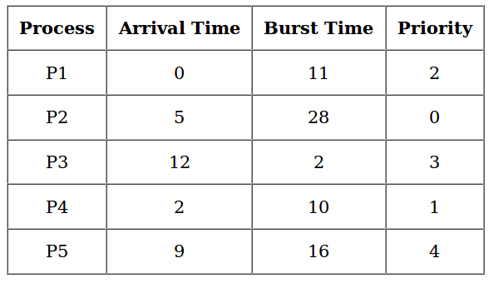

Slide 17
